Slide 1
Web Apps
Dr. Leon Jololian

Slide 2
Table of Contents
HTTP – Hypertext Transfer Protocol
Node.js and npm
Deploying a Web App on the Cloud
REST – Representational State Transfer

Slide 3
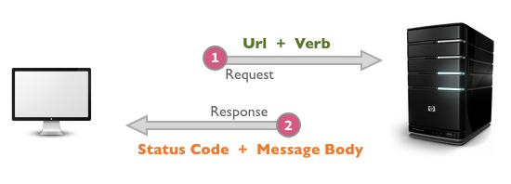
HTTP – Hyper Text Transfer protocol
It's the network protocol used to deliver virtually all files and other data on the WWW.
It's a stateless, application-layer protocol for communicating between distributed systems.

Slide 4
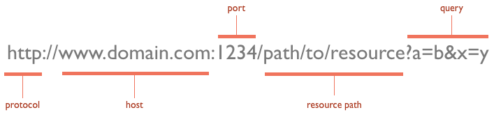
URL
The request message is sent via Uniform Resource Locators (URLs)
A URL has a simple structure that consists of:

Slide 5
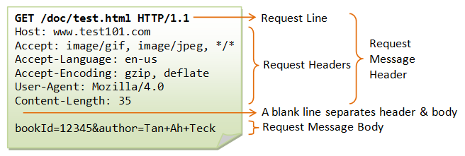
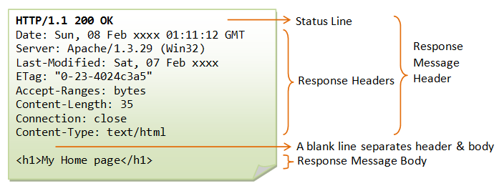

Slide 6
Other HTTP Methods: HEAD and POST
A HEAD request is just like a GET request, except it asks the server to return the response headers only, and not the actual resource (i.e. no message body).
A POST request is used to send data to the server to be processed in some way, like by a CGI script.
A POST request is different from a GET request:
There's a block of data sent with the request, in the message body. There are usually extra headers to describe this message body, like Content-Type: and Content-Length:
The request URI is not a resource to retrieve; it's usually a program to handle the data you're sending
The HTTP response is normally program output, not a static file

Slide 7
Some Methods used for Sending HTTP Requests
GET: get a web resource from the server.
HEAD: get the header that a GET request would have obtained.
POST: post data up to the web server.
PUT: ask the server to store the data.
DELETE: ask the server to delete the data.
TRACE: ask the server to return a diagnostic trace of the actions it takes.
OPTIONS: ask the server to return the list of request methods it supports.

Slide 8
HTTP Response Status Code
1xx (Informational): Request received, server is continuing the process.
2xx (Success): The request was successfully received, understood, accepted and serviced.
3xx (Redirection): Further action must be taken in order to complete the request.
4xx (Client Error): The request contains bad syntax or cannot be understood.
5xx (Server Error): The server failed to fulfill an apparently valid request.

Slide 9
Common Status Codes
200 OK: The request is fulfilled.
400 Bad Request: Server could not interpret or understand the request, probably syntax error in the request message.
401 Authentication Required: The requested resource is protected.
404 Not Found: The requested resource cannot be found in the server.
408 Request Timeout

Slide 10
Example of an HTML Form
<html>
<head><title>Login</title></head>
<body>
<h2>LOGIN</h2>
<form method="get" action="/bin/login">
Username: <input type="text" name="user" size="25" /><br />
Password: <input type="password" name="pw" size="10" /><br /><br />
<input type="hidden" name="action" value="login" />
<input type="submit" value="SEND" />
</form>
</body>
</html>

Slide 11
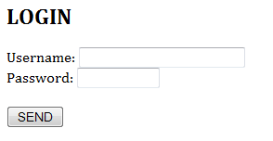
GET /bin/login?user=Peter+Lee&pw=123456&action=login HTTP/1.1
Accept: image/gif, image/jpeg, */*
Referer: http://127.0.0.1:8000/login.html
Accept-Language: en-us
Accept-Encoding: gzip, deflate
User-Agent: Mozilla/4.0 (compatible; MSIE 6.0; Windows NT 5.1)
Host: 127.0.0.1:8000
Connection: Keep-Alive

Slide 12
Node.js
Developed by Ryan Dahl in 2009
A server-side platform built on Google Chrome's JavaScript Engine.
An event-driven, non-blocking I/O model that makes it lightweight and efficient, perfect for data-intensive real-time applications that run across distributed devices.
An open source, cross-platform runtime environment for developing server-side and networking applications.
Can run on OS X, Microsoft Windows, and Linux.
Provides a rich library of JavaScript modules which can simplify the development of web applications.

Slide 13
Installing Node.js on Windows
Download the Windows installer from the Nodes.js® web site: https://nodejs.org/
Double-click on the downloaded file to run the installer
Accept the license agreement and default settings
Restart computer

Slide 14
Creating a Node.js App: “index.js” (Example #1)
var http = require('http');
var server = http.createServer(function(request, response) {
response.writeHead(200, {"Content-Type": "text/plain"});
response.end("Hello World!");
});
var port = process.env.PORT || 1337;
server.listen(port);
console.log("Server running at http://localhost:%d", port);

Slide 15
Steps for Creating App
cd NodeJS
md Example-1
npm init –y
{
"name": "Example-1",
"version": "1.0.0",
"description": "",
"main": "index.js",
"scripts": {
"test": "echo \"Error: no test specified\" && exit 1"
},
"keywords": [],
"author": "",
"license": "ISC"
}
The app folder is
Example-1
Created in the file:
package.json

Slide 16
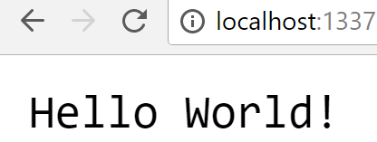
Run the App Locally
Use your favorite text editor to save the code in a file named “index.js”.
Open a CMD window
Use the command node index.js to execute the script.
The app will launch the built in Node.js HTTP server.
Open a web browser, and navigate to the sample app at http://localhost:1337
To end the script, press Ctrl+C in the CMD window.

Slide 17
Deploying Node.js App on the Cloud
Create a Web app on Azure
Deploy the Node.js app to Azure
Update and redeploy the app on Azure
Manage the app on the azure portal

Slide 18
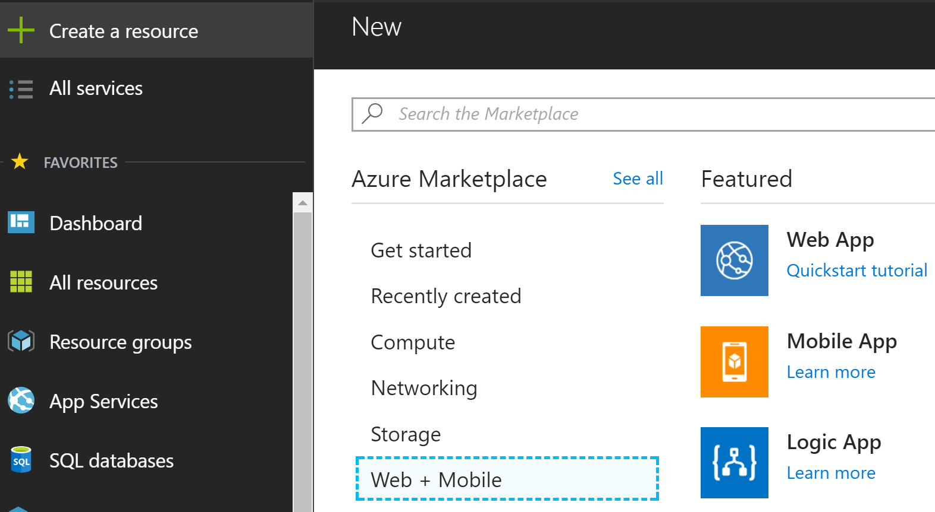
Creating a Web App on the Azure Portal
1
3
2

Slide 19
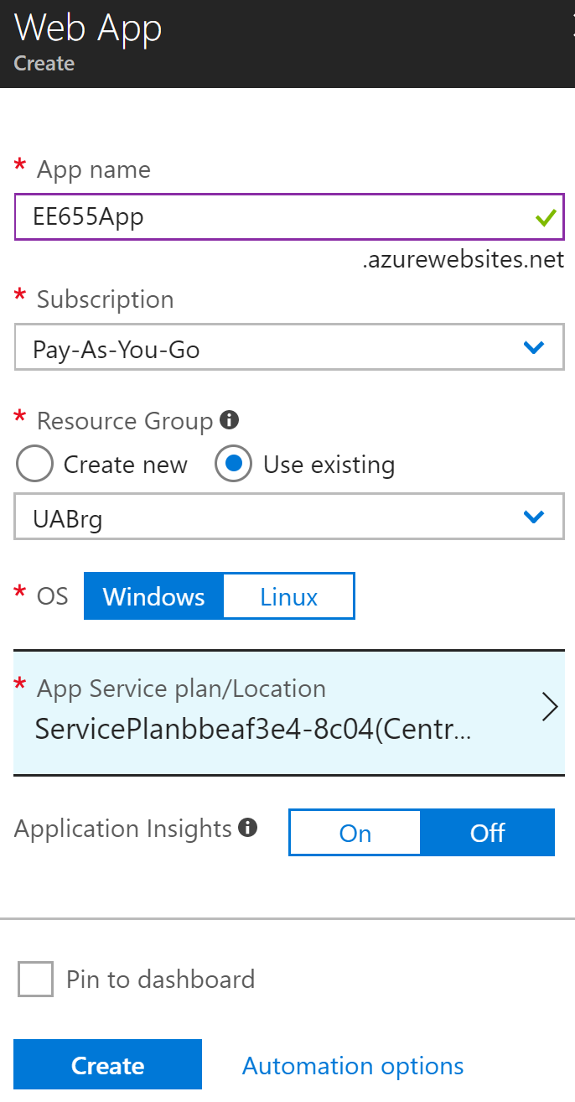
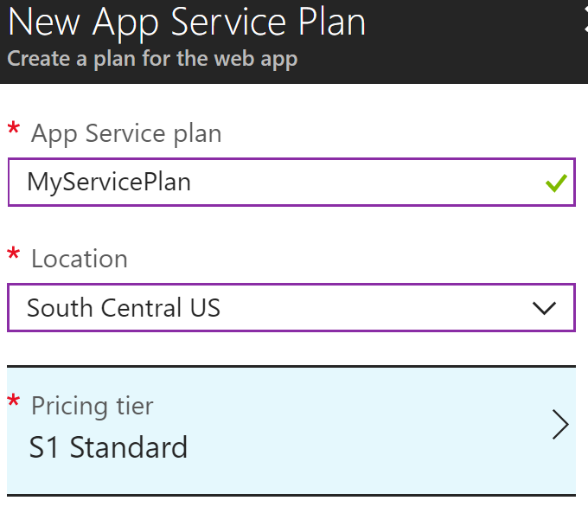
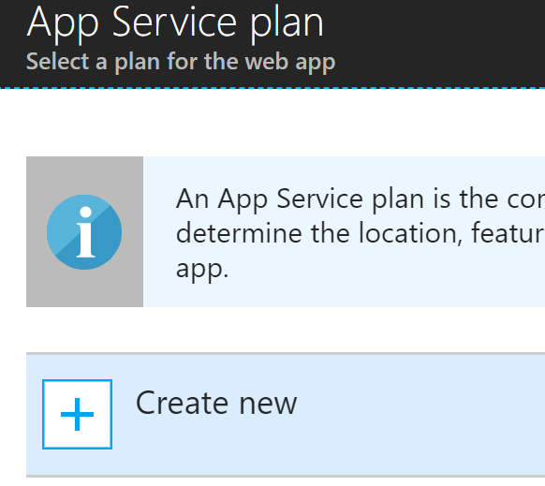
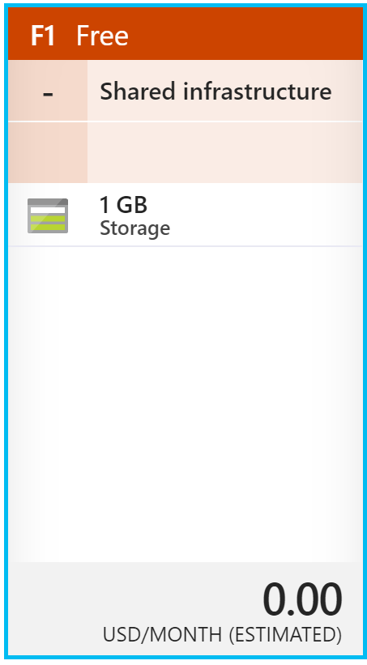
Configuring the Web App

Slide 20
Create a Web App on Azure With CLI
Create a resource group:
az group create --name myResourceGroup --location "West Europe"
To see all supported locations for App Service:
az appservice list-locations
Create an Azure App Service plan
az appservice plan create --name myAppServicePlan --resource-group myResourceGroup --sku FREE
Create a web app
az webapp create --resource-group myResourceGroup --plan myAppServicePlan --name EE655App --runtime "NODE|8.6"
Test the newly created Web app by using the url:
http://EE655App.azurewebsites.net

Slide 21
Deploying the Node.js App (Using the Azure Deployment Web Site)
In the browser, navigate to:
https://ee655app.scm.azurewebsites.net/ZipDeploy
Create a zip file of the folder containing index.js
Upload the ZIP file by dragging it to the file explorer area on the web page.
Upon completing the upload, the message Deployment successful is displayed.
Go to the deployed application using the web browser:
http://EE655App.azurewebsites.net
This completes the Node.js app deployment to App Service.

Slide 22
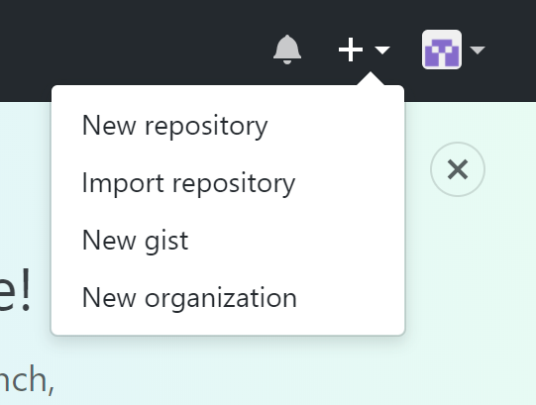
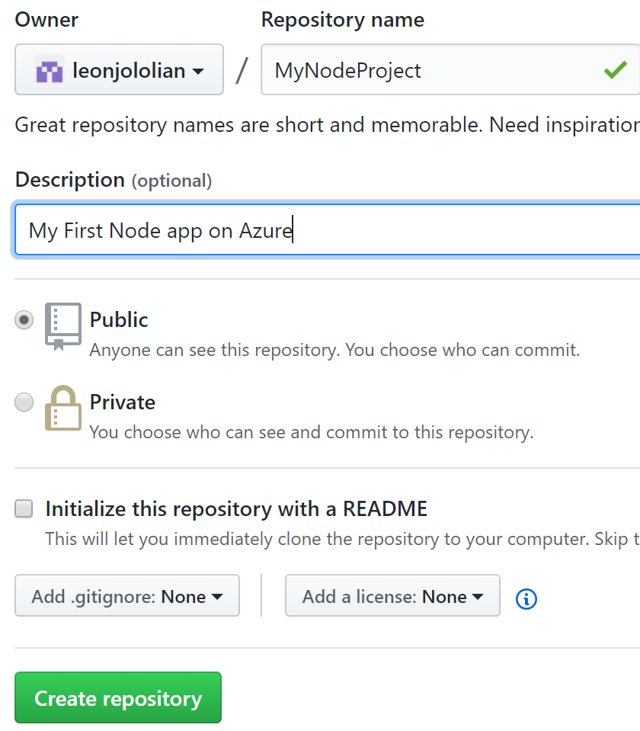
Deploying the Node.js App (Using GitHub)
Go to: https://GitHub.com
Click on + → New repository
Provide name and description for repository.
You can leave the other options as-is
Click on the Create repository button

Slide 23
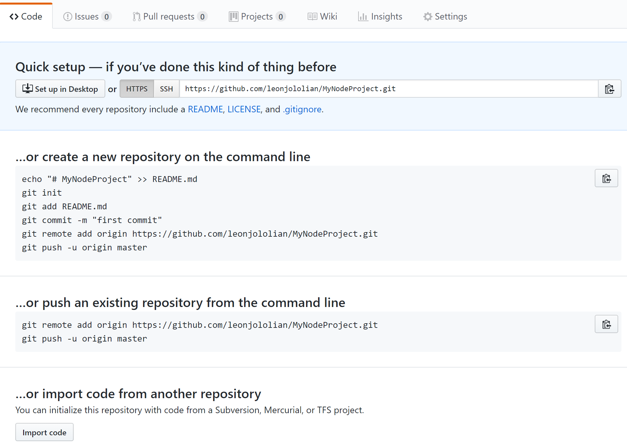
- The following page will be displayed in the browser. - Make note of the command line commands provided. We will be using them to create a local repository on the local machine.

Slide 24
On the local machine:
Go to the directory of the Node JS project
Create a local Git repo: git init
Add the two files to be transferred to GitHub:
git add index.js
git add package.json
git commit –m "My first commit"
git remote add origin https://github.com/....
git push –u origin master
Note that we did not include the folder node_modules in our upload to GitHub.
On the “MyNodeProject” page within the GitHub web site, when the page is refreshed, the two files that were added to the repository will be seen.

Slide 25
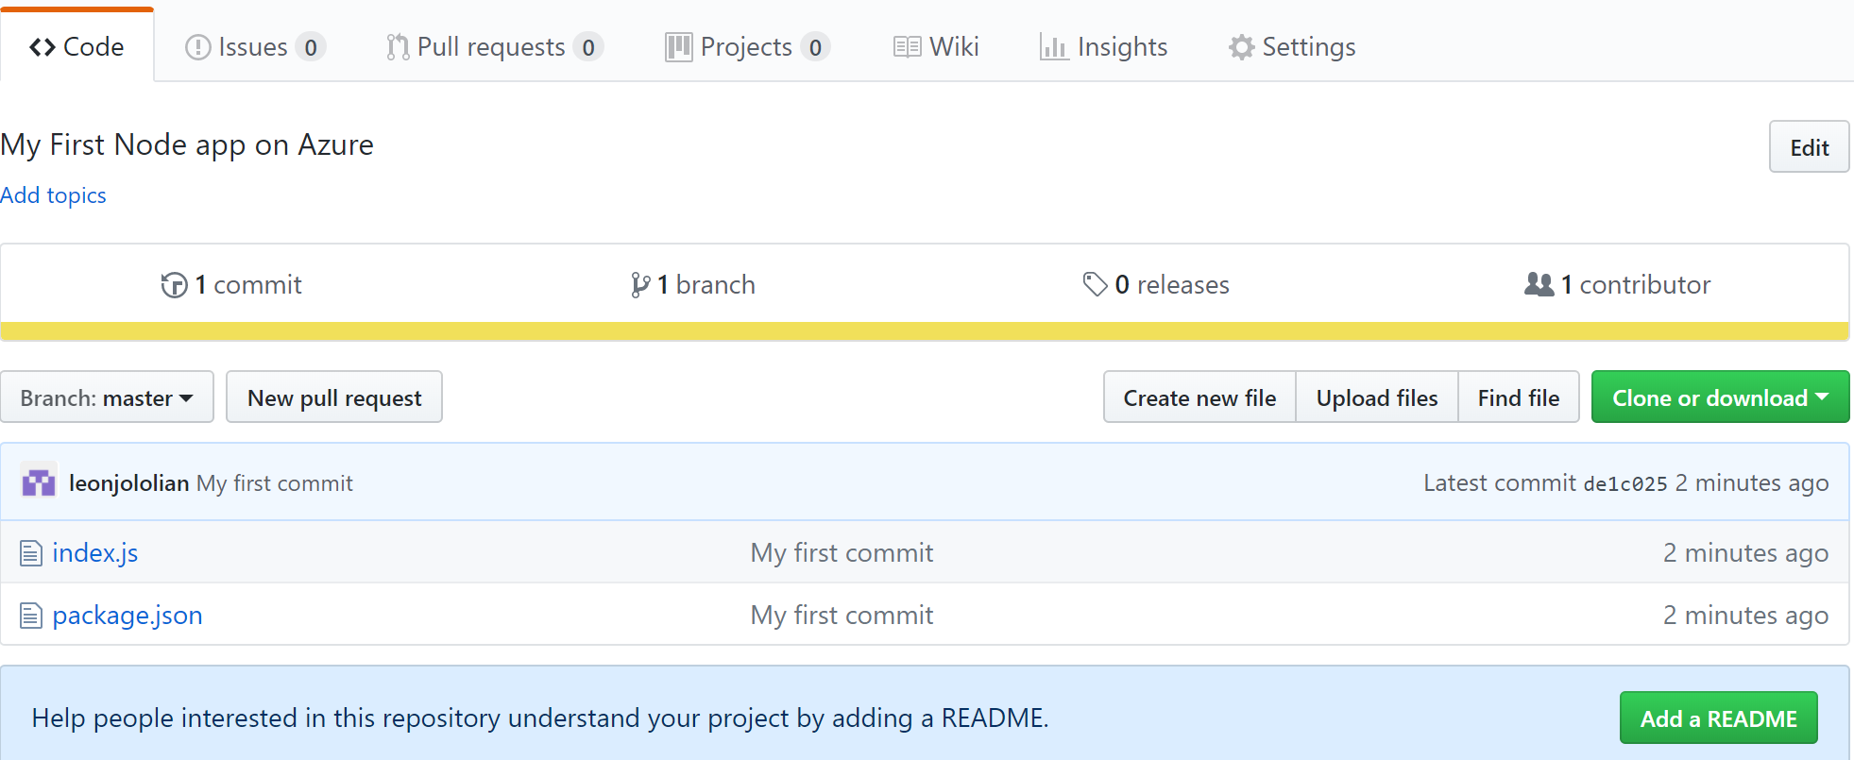
The GitHub page for this project, after the git push command. The two files have been uploaded.

Slide 26
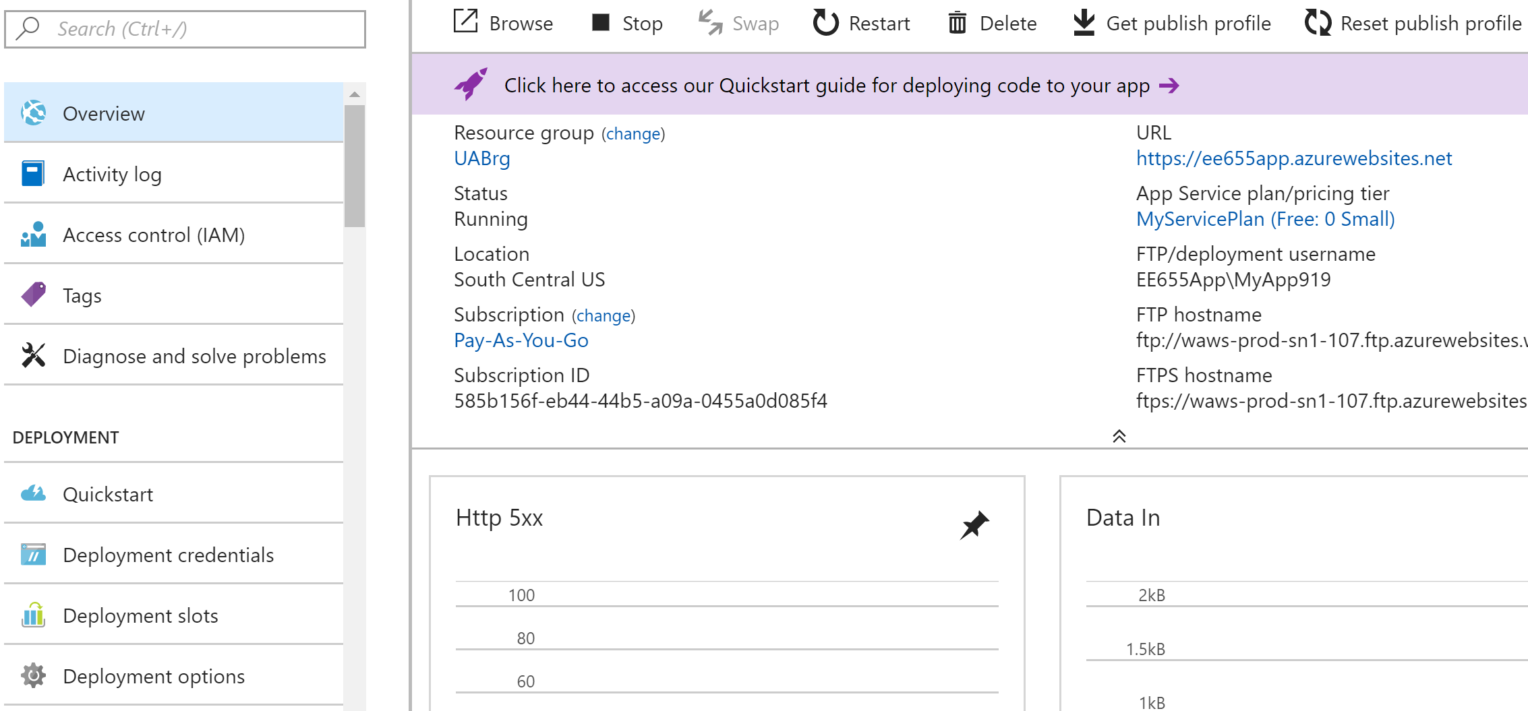
On the Azure Web portal, go to the Web app created earlier, so we can configure it for GitHub.
Click on Deployment options

Slide 27
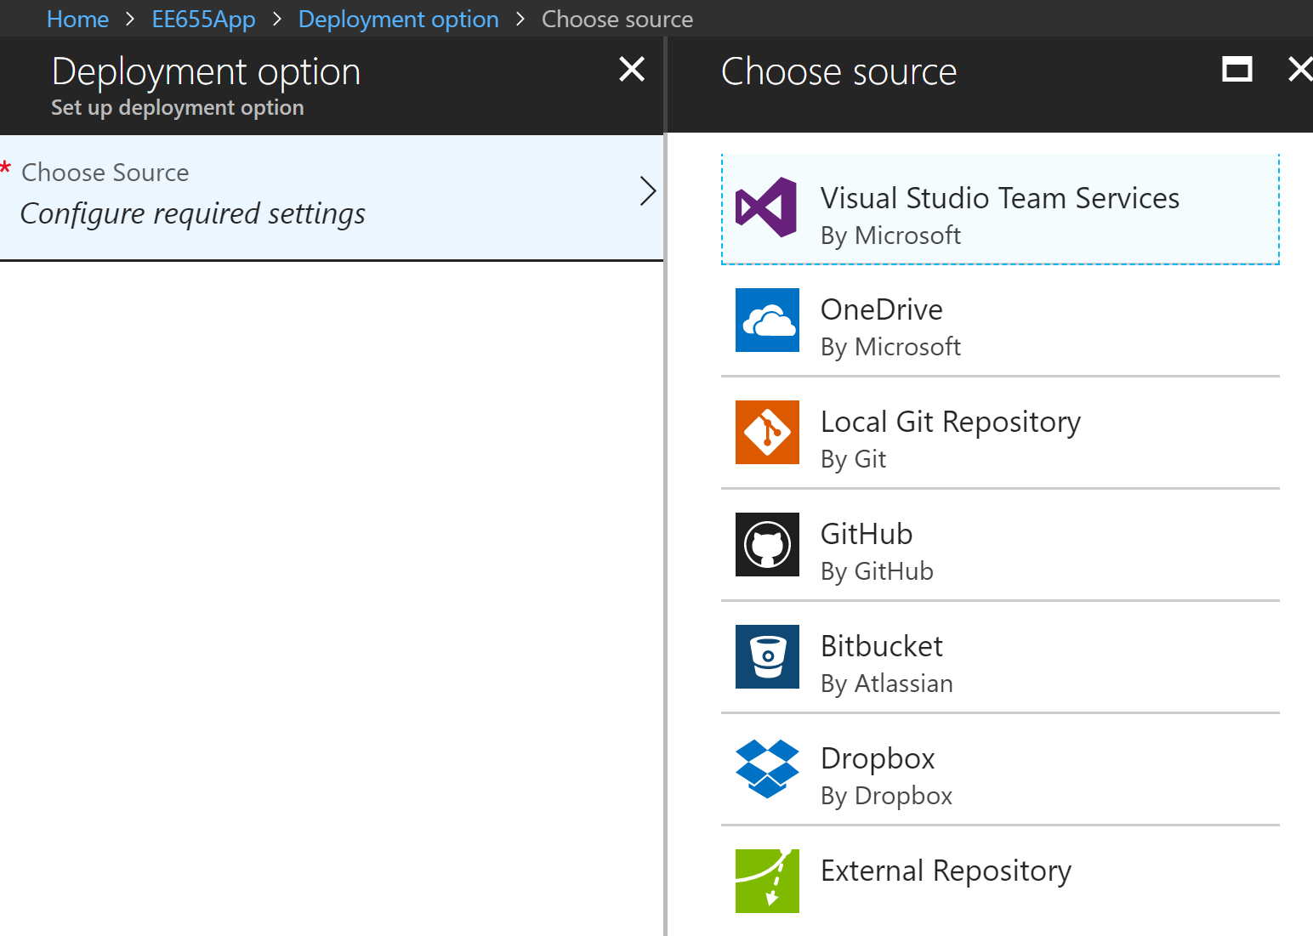
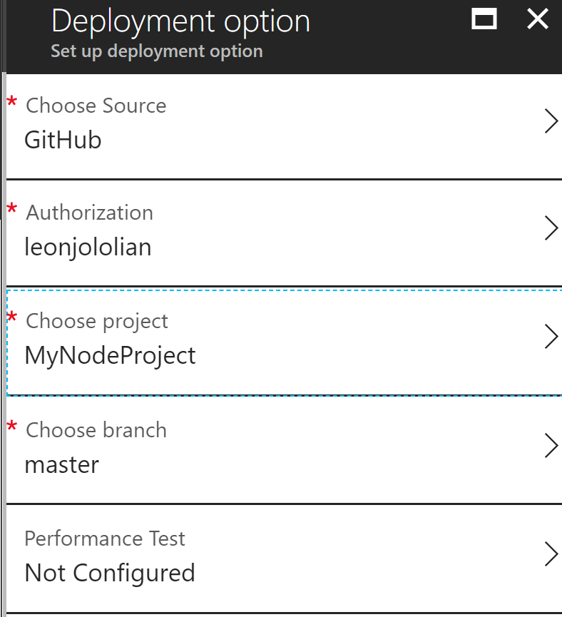
Select GitHub
GitHub credentials
The project on GitHub
The branch (or version)
of the project on GitHub

Slide 28
Update and Redeploy the App
Using a text editor, open the index.js file in the Node.js app, and modify the response.end statement:
response.end("Hello Azure!");
In the local CMD window, navigate to the application's root directory, create a new ZIP file for the updated project.
Deploy the new version using the previous deployment steps.
Reload the App page in the browser:
http://MyApp9876.azurewebsites.net

Slide 29
Managing an Azure Web App
On the Azure portal:
From the left menu, click App Services, and then click the name of the Azure web app.
Basic management tasks can be performed such as, browse, stop, start, restart, and delete.
To delete the app from the cloud:
az group delete --name myResourceGroup

Slide 30
REST – Representational State Transfer
It stands for REpresentational State Transfer.
It is about accessing resources using a common interface based on HTTP protocol.
A REST Server simply provides access to resources and REST client accesses and modifies the resources using HTTP protocol. Each resource is identified by URIs/ global IDs.
REST uses various representation to represent a resource like text, JSON, XML. However, JSON is the most popular one.

Slide 31
HTTP methods
The following four HTTP methods are commonly used in REST based architecture:
GET - read only access to a resource.
PUT - create a new resource.
DELETE - remove a resource.
POST - update a existing resource or create a new resource.

Slide 32
RESTful Web Services
A web service is a collection of open protocols and standards used for exchanging data between applications or systems.
Software applications written in various programming languages and running on various platforms can use web services to exchange data.
This interoperability (e.g., communication between Java and Python, or Windows and Linux applications) is due to the use of open standards.
Web services based on REST Architecture are known as RESTful web services. These web services uses HTTP methods to implement the concept of REST architecture. A RESTful web service usually defines a URI, Uniform Resource Identifier a service, which provides resource representation such as JSON and set of HTTP Methods.

Slide 33
Example in Using RESTful Services
Example 1: A RESTful server that responds to requests from clients to return server maintained data in JSON format.
Example 2: A RESTful server that allows clients to modify server-side data.
Example 3: A RESTful server that accepts requests to delete server-side data.

Slide 34
JSON Based Database of Users
{
"person1" : {
"first_name" : "Tim",
"last_name" : "Cook",
"id": 1
},
"person2" : {
"first_name" : "Jeff",
"last_name" : "Bezos",
"id": 2
},
"person3" : {
"first_name" : "Satya",
"last_name" : "Nadella",
"id": 3
}
}
File Name:
persons.json

Slide 35
Installing and Running the Code
Create a folder for this project
Initialize the project with the command: npm init
Run the following command in the project folder:
npm install express –save
npm install body-parser –save
npm install multer --save
Create the file persons.json with the file contents from the previous slide.
Run server with the command: node index
On the browser, go to the url:
http://localhost:3000/ListPersons

Slide 36
Example 1: REST-ful API to get data from server
var express = require('express');
var app = express();
var fs = require("fs");
app.get('/listPersons', function (req, res) {
fs.readFile( __dirname + "/" + "persons.json", 'utf8', function (err, data) {
console.log( data );
res.end( data );
});
})
var server = app.listen(3000, function () {
console.log("App listening on port 3000")
})

Slide 37
Example 2: RESTful Service to Modify Data
<html>
<body>
<form action = http://127.0.0.1:3000/addPerson method = "POST">
First Name: <input type = "text" name = "first_name"> <br>
Last Name: <input type = "text" name = "last_name"> <br>
ID: <input type = "text" name = "id">
<input type = "submit" value = "Submit">
</form>
</body>
</html>

Slide 38
var express = require('express');
var app = express();
var fs = require("fs");
var bodyParser = require('body-parser');
var urlencodedParser = bodyParser.urlencoded({ extended: false })
var server = app.listen(3000, function () {
console.log("App listening on port 3000")
})
app.get('/index.html', function (req, res) {
res.sendFile( __dirname + "/" + "index.html" );
})

Slide 39
app.post('/addPerson', urlencodedParser, function (req, res) {
var person = {
"person4" : {
"first_name" : req.body.first_name,
"last_name" : req.body.last_name,
"id": req.body.id
}
}
fs.readFile( __dirname + "/" + "persons.json",
'utf8', function (err, data) {
data = JSON.parse( data );
data["person4"] = person["person4"];
console.log( data );
res.end( JSON.stringify(data));
});
})

Slide 40
Example 3: A RESTful Service to Delete Data
<html>
<body>
<h2> ID of person to delete </h2>
<form action = "http://127.0.0.1:3000/deletePerson" method = "POST">
ID: <input type = "text" name = "id">
<input type = "submit" value = "Submit">
</form>
</body>
</html>

Slide 41
var express = require('express');
var app = express();
var fs = require("fs");
var bodyParser = require('body-parser');
var urlencodedParser = bodyParser.urlencoded({ extended: false })
var server = app.listen(3000, function () {
console.log("App listening at port 3000")
})
app.get('/index.html', function (req, res) {
res.sendFile( __dirname + "/" + "index.html" );
})

Slide 42
app.post('/deletePerson', urlencodedParser, function (req, res) {
fs.readFile( __dirname + "/" + "persons.json", 'utf8', function (err, data) {
data = JSON.parse(data);
delete data["person" + req.body.id];
console.log( data );
res.end( JSON.stringify(data));
fs.writeFile('persons-2.json',
JSON.stringify(data, null, "\t"), (err) => {
if (err) throw err;
console.log('Output to file complete.');
});
});
})

Slide 43
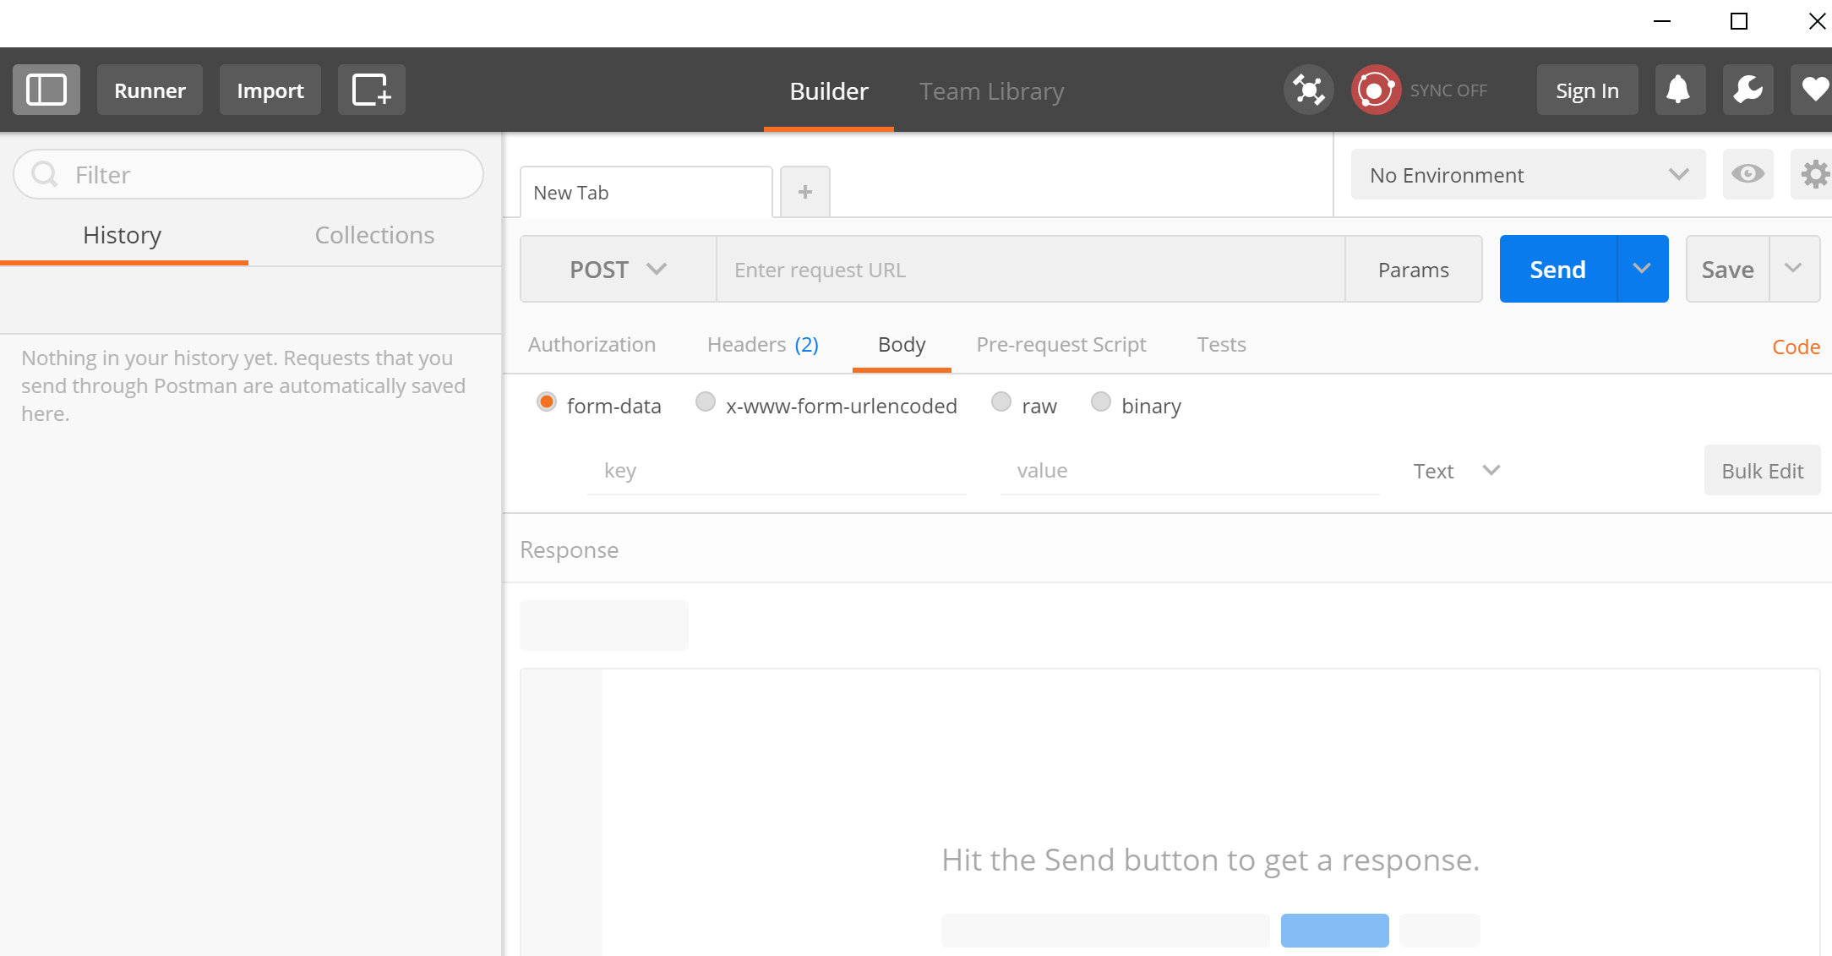
Postman
Postman is a Web REST client that allows you to enter and monitor HTTP requests and responses.
It can be installed as a Chrome add-on. It is available from the Chrome Web Store (https://chrome.google.com/webstore/category/apps )

Slide 44
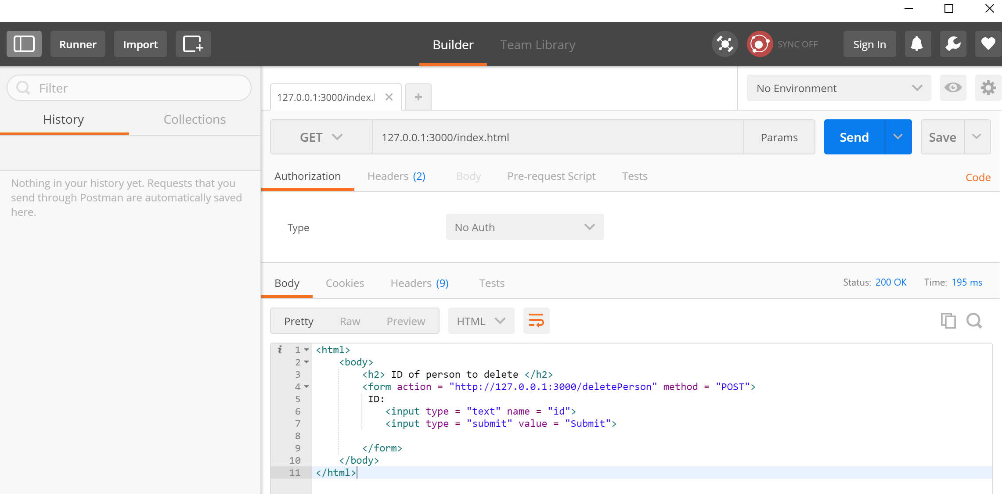
Example

Slide 45
var express = require('express');
var app = express();
var fs = require("fs");
var server = app.listen(3000, function () {
console.log("App listening at port 3000")
})
app.get('/index.html', function (req, res) {
res.sendFile( __dirname + "/" + "index.html" );
})
app.delete('/deletePerson/:id', function (req, res) {
fs.readFile( __dirname + "/" + "persons.json", 'utf8', function (err, data) {
data = JSON.parse(data);
const req_id = req.params.id;
delete data["person" + req_id];
res.end( JSON.stringify(data));
fs.writeFile(__dirname + "/" + "persons.json", JSON.stringify(data), function(err) {
if (err) { return console.error(err); }
})
})
})

Slide 46
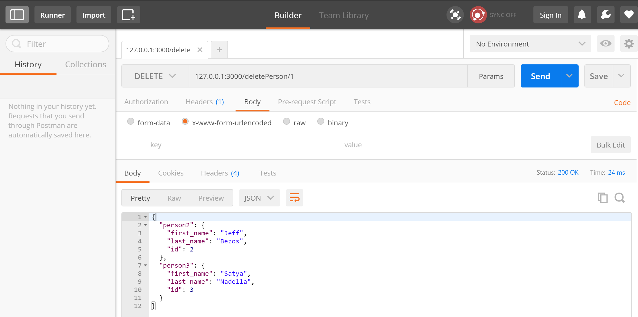

Slide 47
Show a Person Details
var express = require('express');
var app = express();
var fs = require("fs");
app.get('/:id', function (req, res) {
fs.readFile( __dirname + "/" + "persons.json", function (err, data) {
persons = JSON.parse(data);
var person = persons["person" + req.params.id]
console.log(person);
res.end( JSON.stringify(person));
});
})
var server = app.listen(3000, "127.0.0.1", function () {
var host = server.address().address
var port = server.address().port
console.log("Example app listening at http://%s:%s", host, port)
})

Slide 48
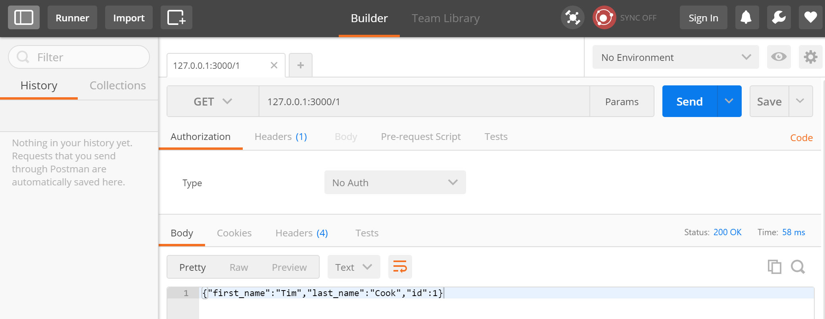

Slide 49
(process_get.js)
How to Pass Parameters with Postman, using the GET Method?
var express = require('express');
var app = express();
app.use(express.static('public'));
app.get('/index.html', function (req, res) {
res.sendFile( __dirname + "/" + "index.html" );
})
app.get('/process_get', function (req, res) {
response = {
first : req.query.first_name,
last : req.query.last_name
};
console.log(response);
res.end(JSON.stringify(response));
})
var server = app.listen(3000, function () {
var host = server.address().address
var port = server.address().port
console.log("Example app listening at http://%s:%s", host, port)
})

Slide 50
Previously We used:
<html>
<body>
<form action = "http://127.0.0.1:3000/process_get" method = "GET">
First Name: <input type = "text" name = "first_name"> <br>
Last Name: <input type = "text" name = "last_name">
<input type = "submit" value = "Submit">
</form>
</body>
</html>

Slide 51
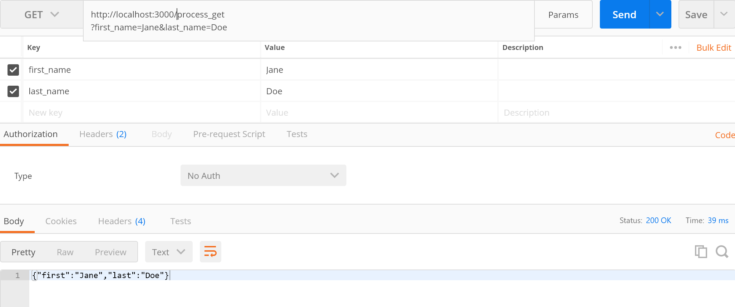

Slide 52
(process_post.js)
How to Pass Parameters with Postman, using the POST Method?
var express = require('express');
var app = express();
var bodyParser = require('body-parser');
var urlencodedParser = bodyParser.urlencoded({ extended: false })
app.use(express.static('public'));
app.get('/index.htm', function (req, res) {
res.sendFile( __dirname + "/" + "index.htm" );
})
app.post('/process_post', urlencodedParser, function (req, res) {
response = {
first_name:req.body.first_name, last_name:req.body.last_name };
console.log(response);
res.end(JSON.stringify(response));
})
var server = app.listen(3000, function () {
console.log("listening at port 3000")
})

Slide 53
Previously we used:
<html>
<body>
<form action = "http://127.0.0.1:3000/process_post" method = "POST">
First Name: <input type = "text" name = "first_name"> <br>
Last Name: <input type = "text" name = "last_name">
<input type = "submit" value = "Submit">
</form>
</body>
</html>

Slide 54
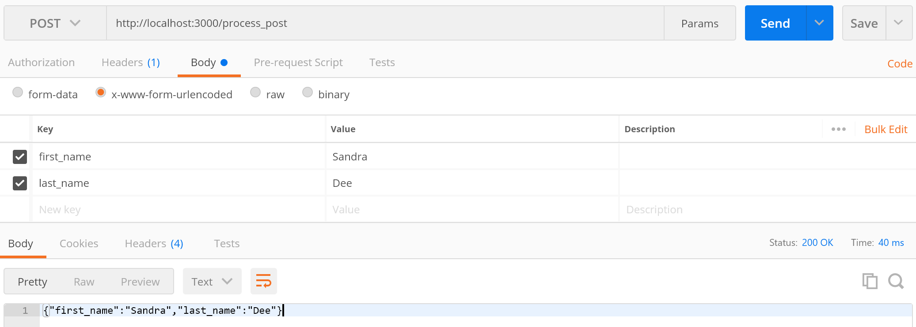

Slide 55
Node.js App Access to Cloud Database
Create the Node.js app
Verify connectivity to database on Azure
An app to access/modify database

Slide 56
Creating the Node.js App
We will create a simple Node.js app to perform basic CRUD operations: Insert, Update, Delete, and Select.
In a Windows CMD window, type the following commands:
cd ~/
mkdir SqlCRUD
cd SqlCRUD
npm init -y
npm install tedious
npm install async

Slide 57
Example #1: Verify Connection to the DB on Azure
var Connection = require('tedious').Connection;
var Request = require('tedious').Request;
var TYPES = require('tedious').TYPES;
var dbconfig = {
userName: 'leon',
password: 'password',
server: 'mydbserver123.database.windows.net',
options: { database: 'MyDB',
encrypt: true
}
}
var connection = new Connection(dbconfig);
connection.on('connect', function(err) {
if (err) { console.log(err); }
else { console.log('Connected'); }
});
Note:
Replace values highlighted in blue

Slide 58
Example #2: Program to Perform DB Operations
var Connection = require('tedious').Connection;
var Request = require('tedious').Request;
var TYPES = require('tedious').TYPES;
var async = require('async');
var dbconfig = {
userName: 'leon',
password: 'password',
server: 'mydbserver123.database.windows.net',
options: { database: 'MyDB', encrypt: true }
}
var connection = new Connection(dbconfig);

Slide 59
connection.on('connect', function(err) {
if (err) {
console.log(err);
} else {
console.log('Connected');
async.waterfall([
Start,
Insert,
Update,
Delete,
Read
], Complete)
}
});

Slide 60
function Start(callback) {
console.log('Starting...');
callback(null, 'Done');
}
function Complete(err, result) {
if (err) {
callback(err);
} else {
console.log("Status:" + result);
}
}

Slide 61
function Update(id, newCreditLimit, callback) {
console.log('Updating credit Limit of ID=' + id + ' to ' + newCreditLimit);
request = new Request(
'UPDATE Customer SET CreditLimit=@CreditLimit WHERE ID = @ID;',
function(err, rowCount, rows) {
if (err) {
callback(err);
} else {
console.log(rowCount + ' row(s) updated');
callback(null, 'Sally', 'Address #4', 333);
}
});
request.addParameter('ID', TYPES.NVarChar, id);
request.addParameter('CreditLimit', TYPES.NVarChar, newCreditLimit);
connection.execSql(request);
}

Slide 62
function Insert(name, address, creditLimit, callback) {
console.log("Inserting '" + name + "' into Table...");
request = new Request(
'INSERT INTO Customer (Nmae, Address, CreditLimit) OUTPUT INSERTED.Id VALUES (@Name, @Address, @CreditLimit);',
function(err, rowCount, rows) {
if (err) {
callback(err);
} else {
console.log(rowCount + ' row(s) inserted');
callback(null, 'xxx', 'yyy');
}
});
request.addParameter('Name', TYPES.NVarChar, name);
request.addParameter('Address', TYPES.NVarChar, address);
request.addParameter('CreditLimit', TYPES.NVarChar, creditLimit);
connection.execSql(request);
}

Slide 63
function Delete(name, callback) {
console.log("Deleting '" + name + "' from Table...");
request = new Request(
'DELETE FROM Customer WHERE Nmae = @Name;',
function(err, rowCount, rows) {
if (err) {
callback(err);
} else {
console.log(rowCount + ' row(s) deleted');
callback(null);
}
});
request.addParameter('Name', TYPES.NVarChar, name);
connection.execSql(request);
}

Slide 64
function Read(callback) {
console.log('Reading rows from the Table...');
request = new Request(
'SELECT Id, Nmae, Address, CreditLimit FROM Customer;',
function(err, rowCount, rows) {
if (err) {
callback(err);
} else {
console.log(rowCount + ' row(s) returned');
callback(null);
}
});

Slide 65
var result = "";
request.on('row', function(columns) {
columns.forEach(function(column) {
if (column.value === null) {
console.log('NULL');
} else {
result += column.value + " ";
}
});
console.log(result);
result = "";
});
connection.execSql(request);
}

